Slide 1


sprint II recap
Android app for events booking - SKG.Code Bootcamp

Slide 2












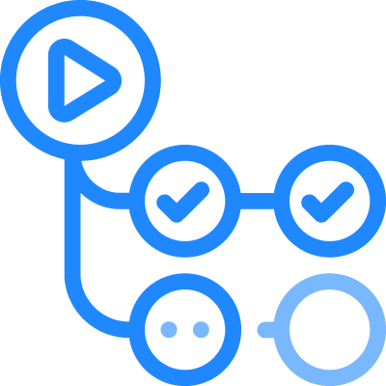

Tools & Technologies
Back-end Development
Front-end Development
API Server
Node.js & Express.js
Database & ORM
MongoDB Atlas & Mongoose
Hosting
Render.com
Insomnia/ Postman
API Testing
Env Vars
Dotenv
Auto-reload
Nodemon
Repository & CI
GitHub
Android Development
Android Studio & Kotlin
RecyclerView
Android Jetpack
HTTP Client
Retrofit
Glide
Image Loading
Planned
Firebase Authentication
UI Mockups
Figma
Repository & CI
GitHub

Slide 3

What We Built – Highlights
Kostantinos Mourousidis
Front & Back End Development
Evdokia Voultsiou
Frontend Development
Efstratia Geragoteli
Back & Front End Development
Home - Search – Event View Screen
Scroll Filter of Categories
Category Quiz for Recommendation section
Map Feature
Chatbot on Event View
User Login Feature & Profile View
Tickets View
Buy Ticket Feature
Paypal/ Credit card Views
Valid Pay View
QRs for purchased tickets
Figma Integration
Event Model (Mongoose)
Seed Script
Deployment
CRUD Endpoints
Favorite View
UI Mockup Figma: https://www.figma.com/design/G0YAXUaPiufBUIwHtjuXM4/Event-Booking-App-UI-Kit---Community--Community-?node-id=2400-6373&t=9QdFXVkdHukKbZg8-0

Slide 4
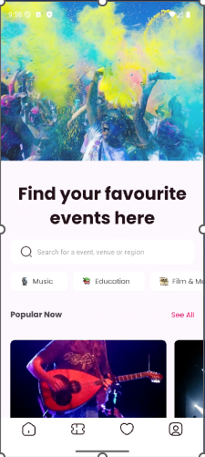
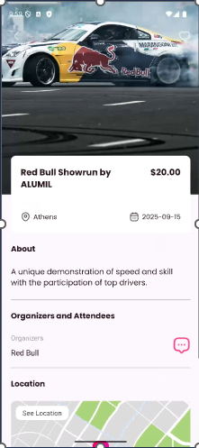
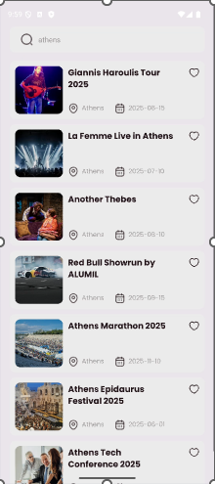
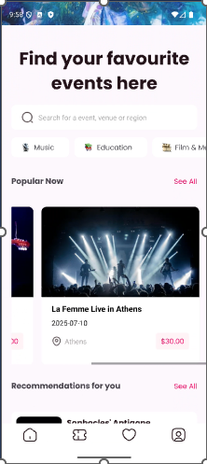
Sprint 1 Goals – Frontend Sprint Backlog
1st View: Home - Filtering
As a user, I want to search and filter events so that I only see events in my city/category/date range.
2nd View: Listed Preview of Events
3rd View: Event’s Detailed Preview
As a user, I want to tap an event preview to view full details.
Popular Events - Carouzel
As a user, I want to see a list of events matching my search and filters.
As a user, I want to see a horizontal carousel of the most anticipated events.

Slide 5
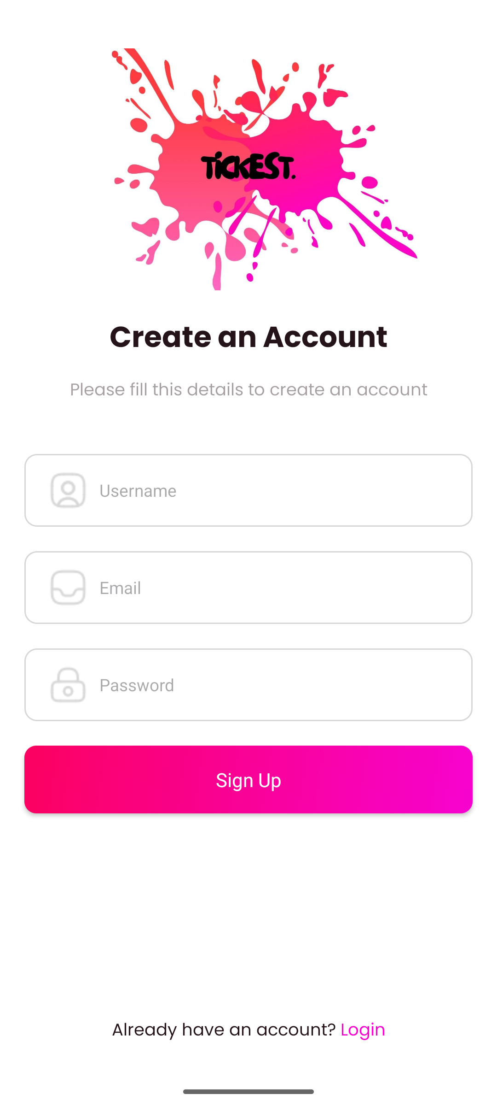
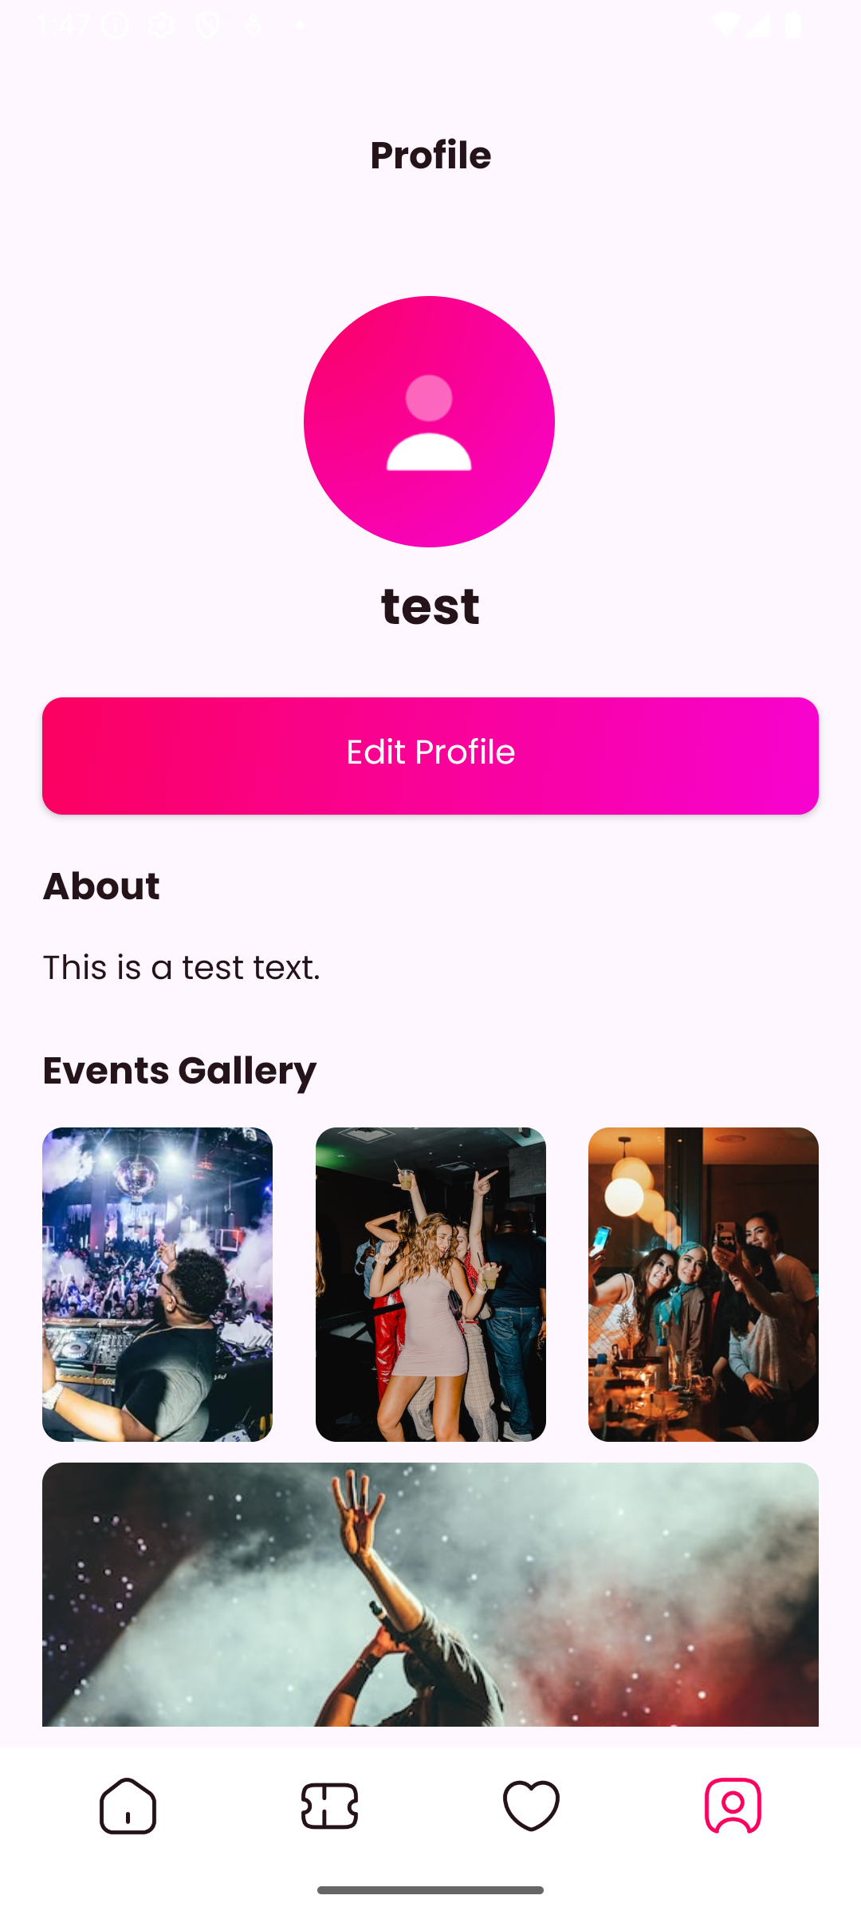
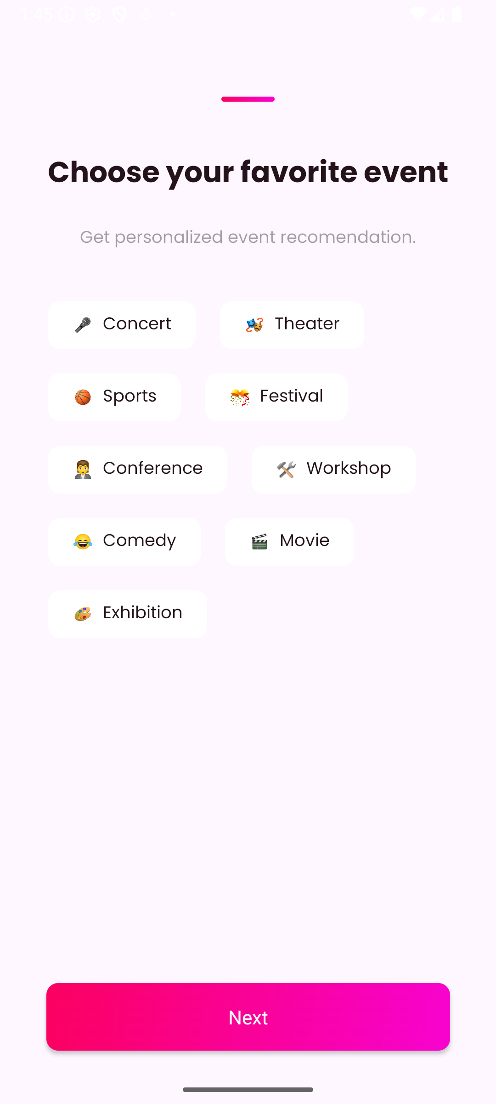
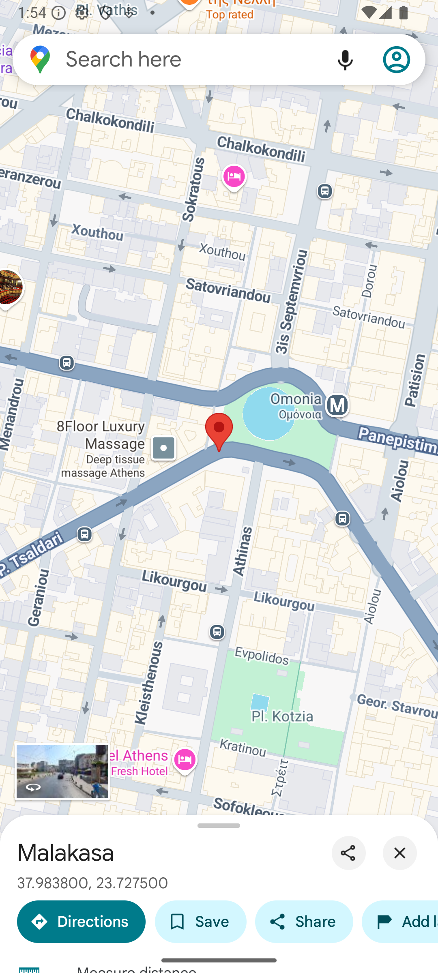
Sprint 1I Goals – Frontend Sprint Backlog
Sign Up – Login User
As a user, I want to create an account so I can book and track tickets.
View: Profile Screen
As a user, I want to view and edit my profile information.
Google Map Redirection
As a user, I want to see recommended events based on the categories I chosen.
As a user, I want to see a map of the venue’s location and redirect to Google Maps.
Category filter for Recom Events

Slide 6
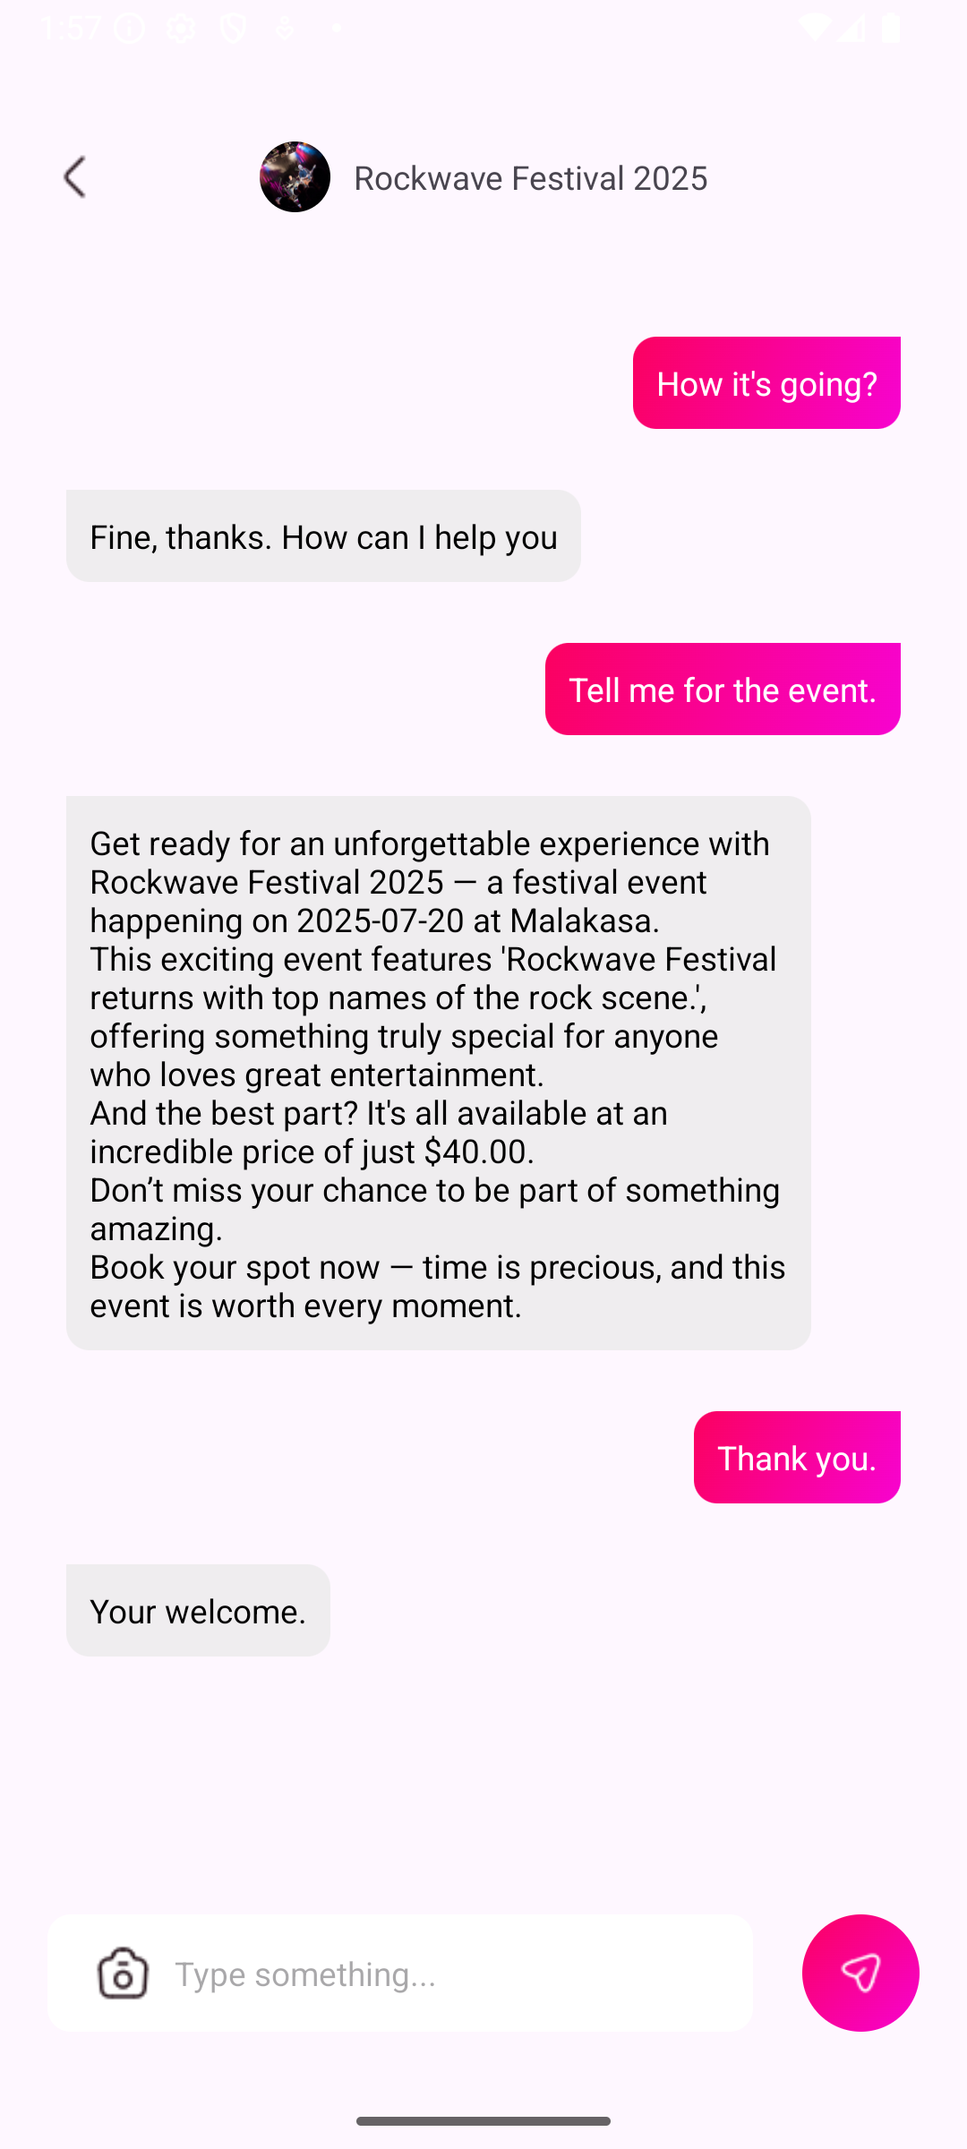
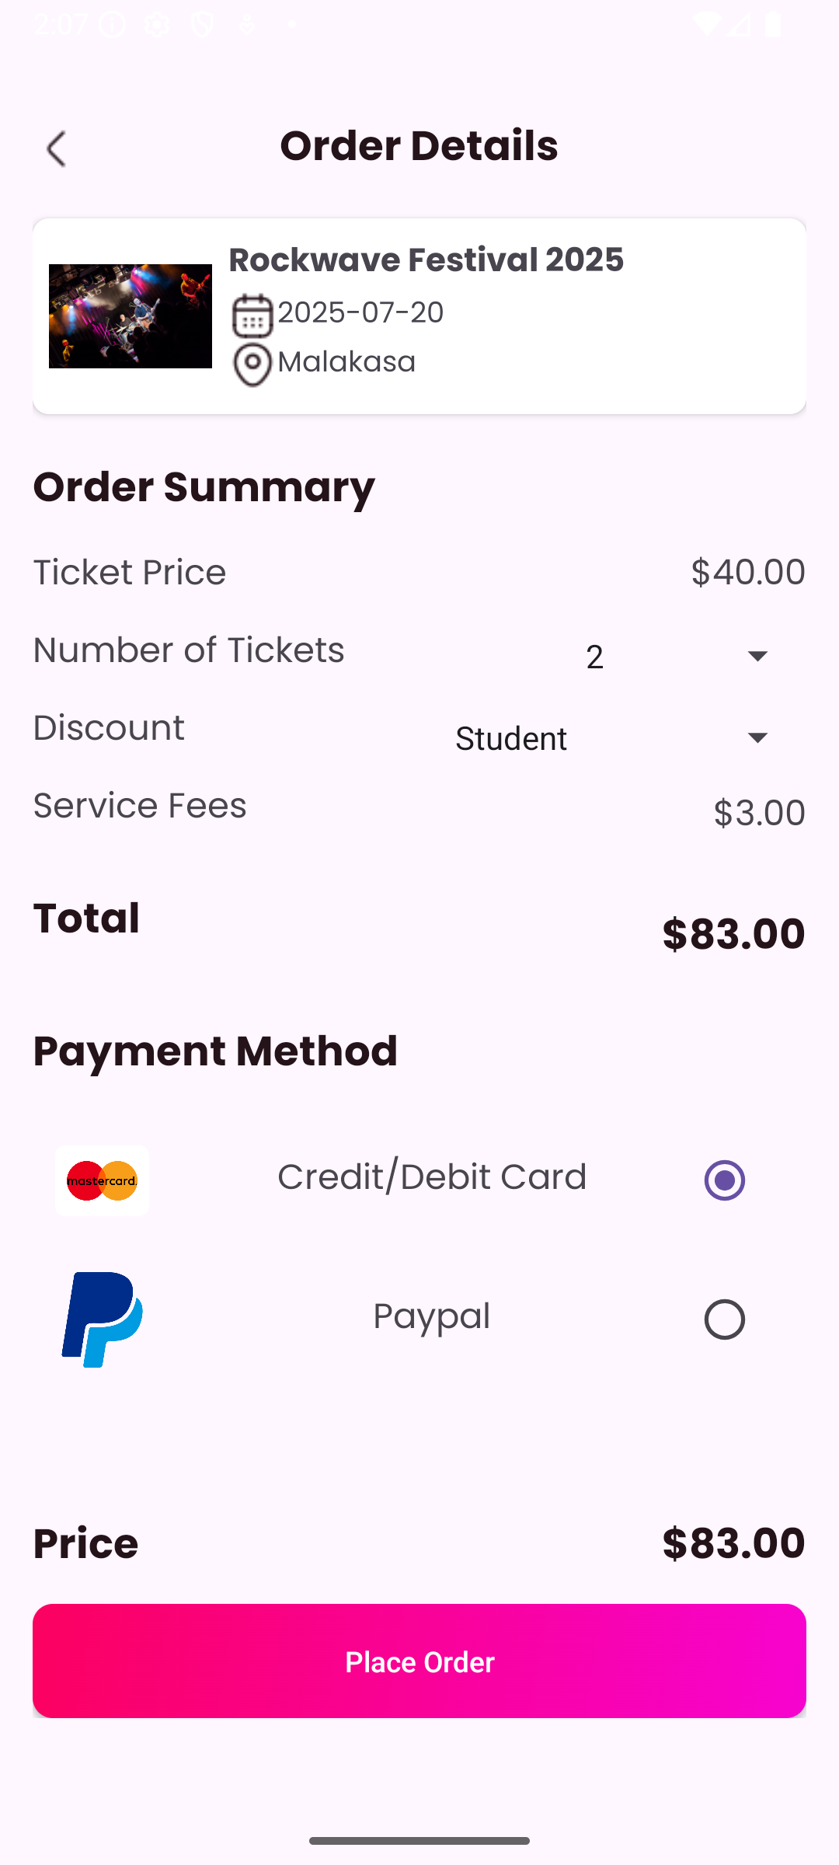
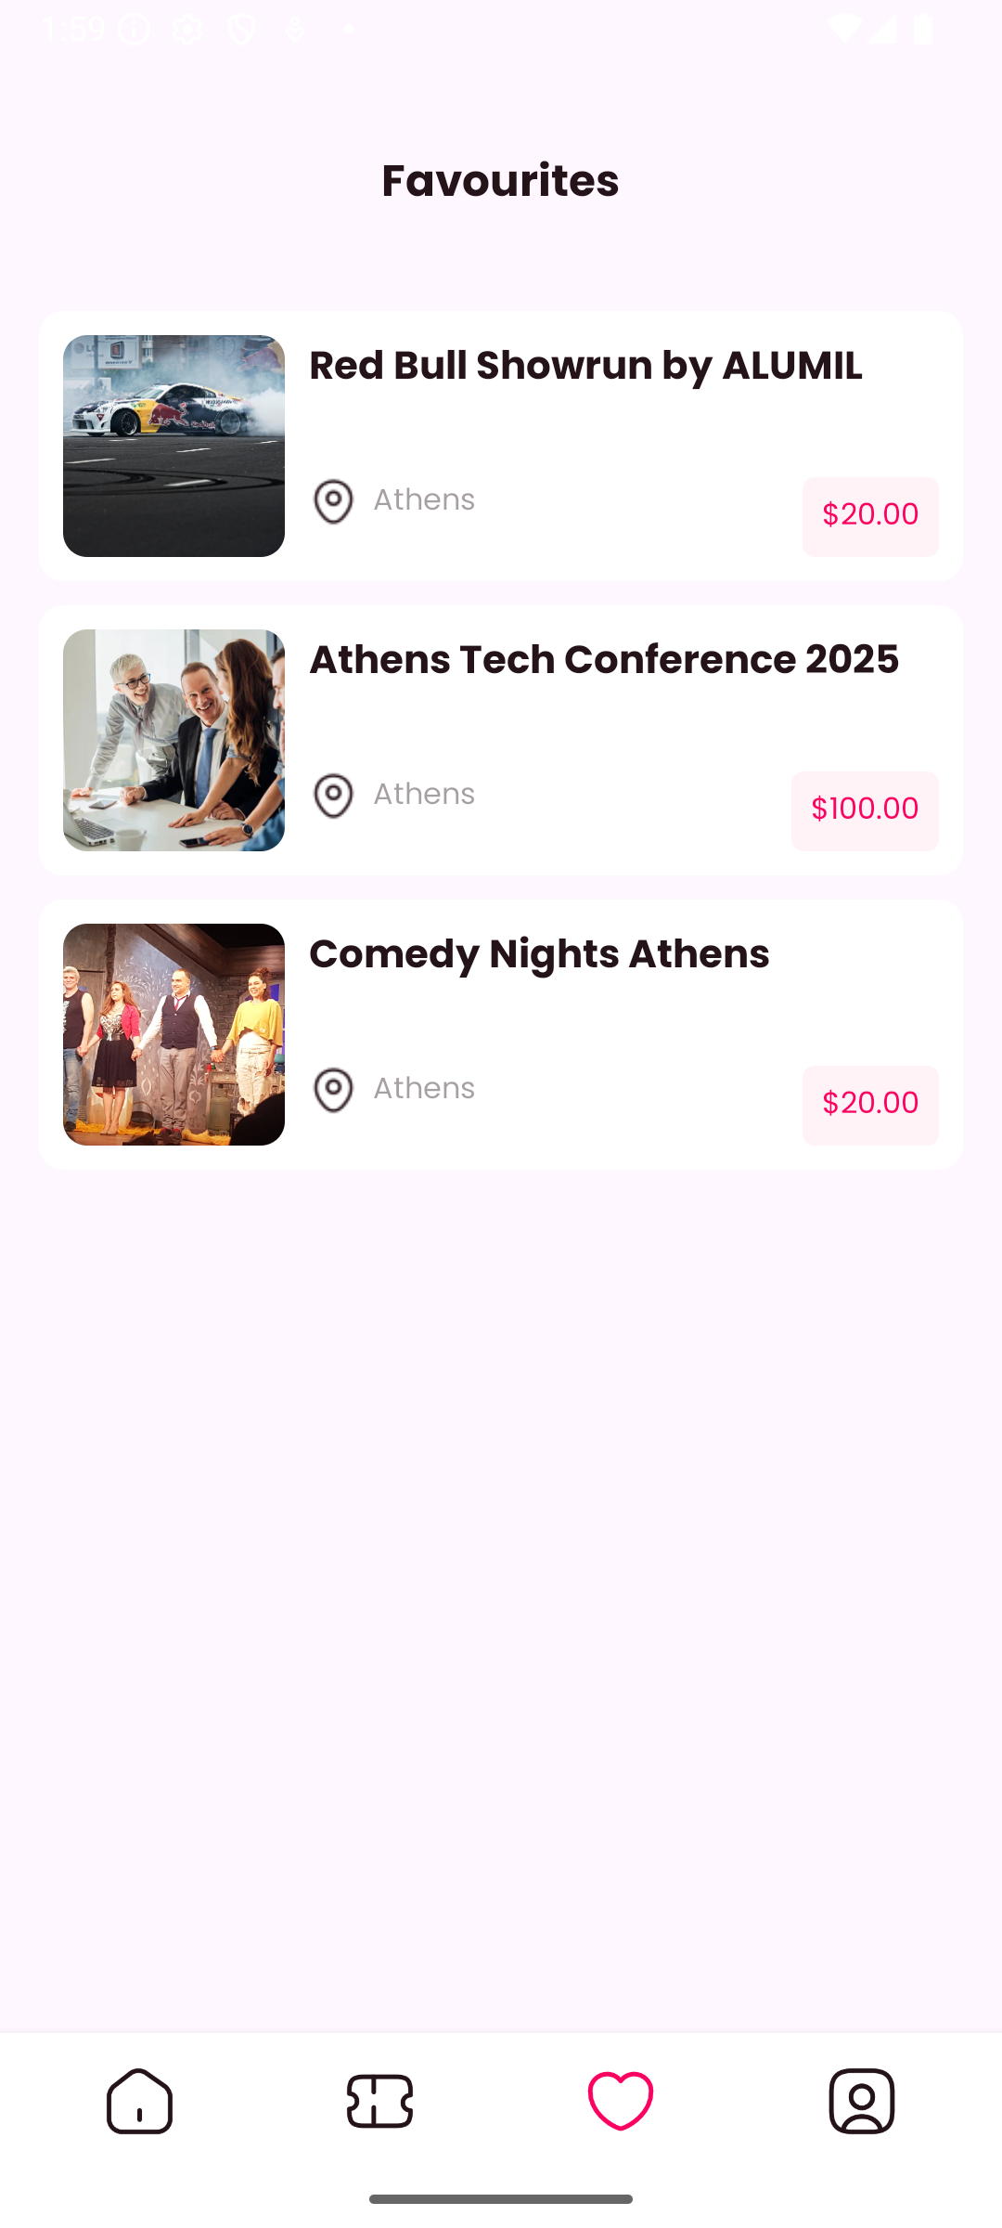
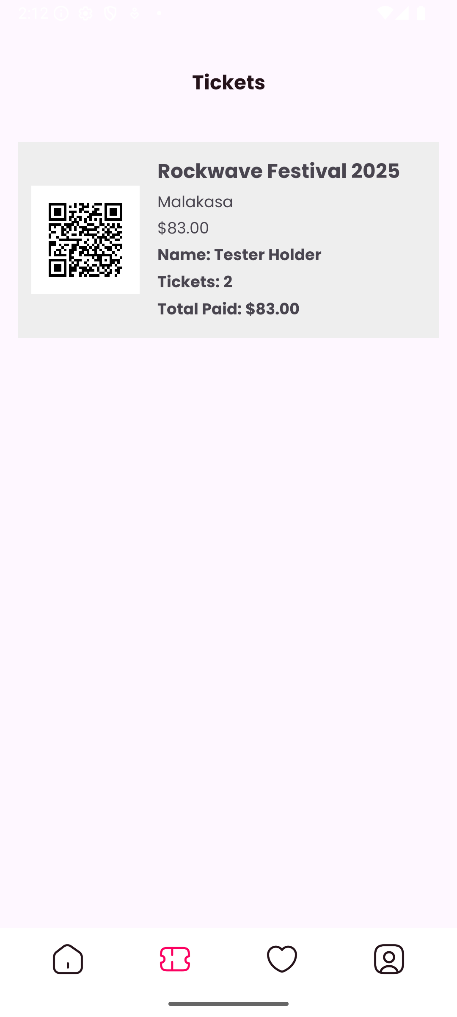
Sprint 1I Goals – Frontend Sprint Backlog
Chatbot Feature
As a user, I want to contact the organizer and ask more information of the event.
Favorite Feature and View
As a user, I want to choose how many tickets I will buy, and I want an instant confirmation with my QR code.
Tickets View
As a user, I want to save my favorite events and review them later.
As a user, I want to review the tickets I bought with their QR code and details.
Order Details Feature & View

Slide 7
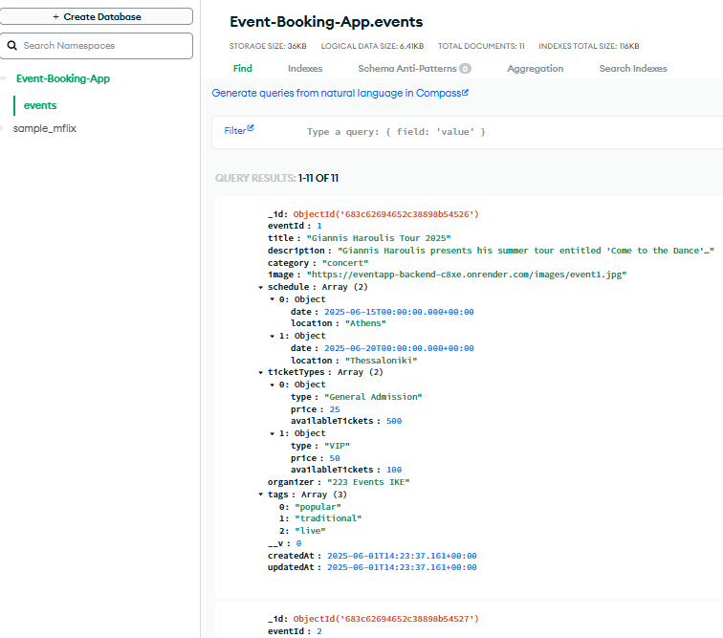
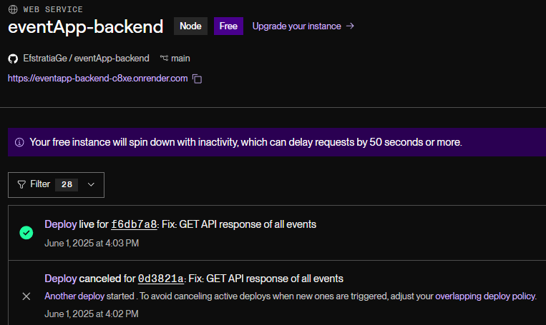
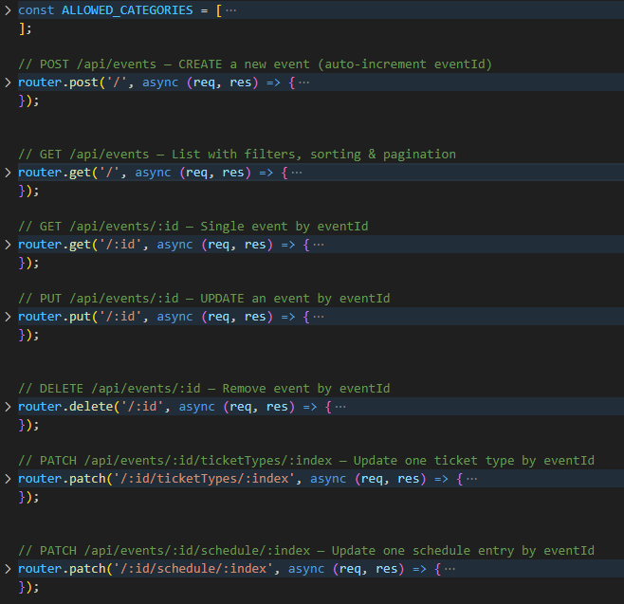
Sprint 1 Goals - Backend Sprint Backlog
API & DB Testing
As a DBA, I want to seed the database with dummy data so that the front-end can test against real-looking events.
CRUD API & DB Connection
As a developer, I want to build a RESTful API with Node.js for all CRUD operations.
BackEnd Hosting & Connection to FrontEnd
As a developer, I want to host my backend repo to Render, so that the frontend dev can fetch the data.

Slide 8


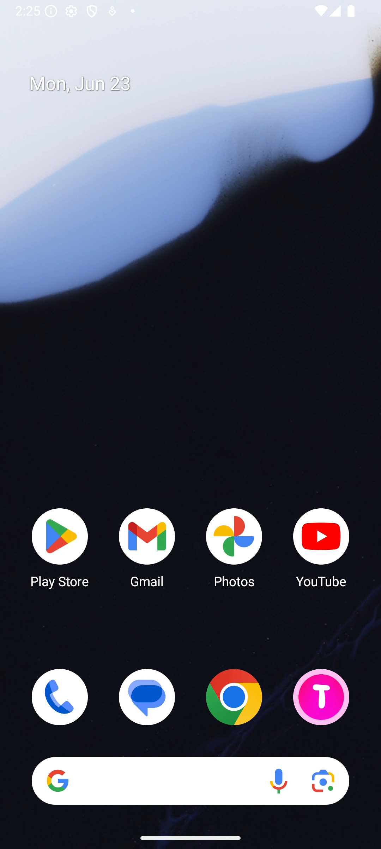
Demo of Current Flow

Slide 9



Goals from Sprint 1
Popular Events feature by click
Favorites View
Google Map Feature (redirection)
Basket/ Cart View
User’s Sign up – User Collection MongoDB
Scroll View of All Categories

Slide 10
Goals for Next Sprint
Popular Events feature by click
Booked Tickets Connection to User Collection
Update event chat for inter-user connection
Profile photo and Events gallery for each user
Notifications of low availability tickets for favorite events
Organizer profile – Connection MongoDB

Slide 11

Thank You
Feel free to ask any questions!

